Slide 1
Evolution of
Big Deal
Analysis
Ken Ladd & Jaclyn McLean
University of Saskatchewan
CLAW 2019

Slide 2

Overview

Slide 3
Evolution 2015 - 2019
2015: simple usage data & aggregate cost analysis
2019: detailed cost per title, analyze packages by college/discipline, add citation data from Web of Science
Notes:
From simple usage data and aggregate cost analysis in 2015 to detailed cost per title, breakdown of packages by college and broad discipline, and the addition of citation data from Web of Science, our program has developed and expanded over the years.
We've analyzed the data annually since 2015, which has become more robust every year; and with the cancellation facing us this year, we got very in-depth. We started our analysis in autumn 2018, updated in spring 2019 and summer 2019
We added all the extra data after the cancellation targets were identified
Initial analysis was on total usage, but when we identified the 2 packages for cancellation, we used only the PDF downloads, with full support from liaison librarians; easier way to compare usage and eliminate differences in platform construction

Slide 4
Big Deal Summary Comparison
 | Cambridge | T&F | Wiley | Springer | Sage | Science Direct | Oxford
Number of titles | 372 | 2,347 | 1,502 | 2,155 | 897 | 2,318 | 356
Cost in 2019 | $ 87,729 | $ 496,669 | $ 924,771 |  | $ 182,879 | $ 1,546,293 | $ 142,861
Cost per average use per year | $ 5.71 | $ 5.06 | $ 4.35 | $ 3.40 | $ 2.85 | $ 2.39 | $ 2.11
Cost per average use <$5 CDN
Number of titles | 21 | 52 | 160 | 54 | 51 | 241 | 89
% all average usage | 42.1% | 14.4% | 42.1% | 19.7% | 37.4% | 45.8% | 72.0%
% package cost | 20.6% | 7.1% | 21.3% | 17.7% | 25.4% | 49.4% | 59.6%
Cost per average use <$10 CDN
Number of titles | 53 | 160 | 315 | 164 | 142 | 496 | 158
% all average usage | 62.3% | 29.8% | 60.8% | 40.6% | 59.7% | 67.0% | 86.1%
% package cost | 46.5% | 28.2% | 52.6% | 61.7% | 85.1% | 113.2% | 107.3%
80 % of all average use per year
Number of titles | 87 | 731 | 418 | 454 | 252 | 526 | 96
% package cost | 72.7% | 415.6% | 187.3% | 377.5% | 219.7% | 206.0% | 107.1%
60 % of all average use per year
Number of titles | 35 | 344 | 191 | 195 | 110 | 245 | 44
% package cost | 59.3% | 224.3% | 91.5% | 217.1% | 106.2% | 119.3% | 61.1%
Notes:
Comparison across packages
We compared 7 packages, but didn't include ACS, IOP, NRC, RSC, and LWW at this time (had a significant cancellation target that had to be met, looking at the smaller packages would not lead to enough savings)
Used a standard currency conversion even though done at slightly different times
Cost in 2019 was the CAD actual. Springer is not included because it was not included in “Expenditures of CARL member libraries for scholarly resource subscriptions licensed through CRKN for 2018 - 2019 / Dépenses des bibliothèques membres de l'ABRC pour les abonnements aux ressources savantes sous licence du RCDR pour l'année 2018 – 2019 », released October 1, 2019: https://www.frdr.ca/repo/handle/doi:10.20383/101.0187

Slide 5
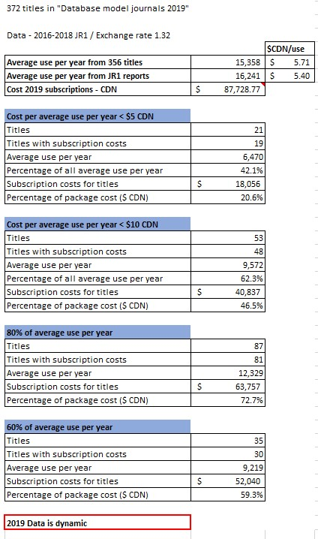
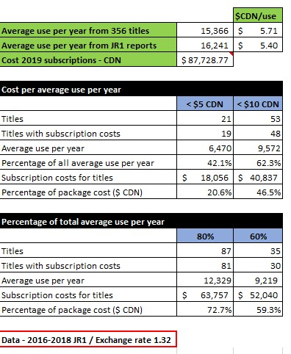
Visualizing the data
New
Notes:
We’ve also worked on simplifying the presentation of the data and the story about the data to our liaison librarians, and this year we had the “opportunity” to test our methodology with a large cancellation project, using our collected data as the foundation.
Visual - comparison of old/new data summary
Both tables include the same data, just organized differently.

Slide 6
Aggregated Data
Publisher
Title
CRKN
Title
Other
Link resolver (alt. coverage)
Price
Core
Packages
COUNTER (JR1)
Subjects
Price
Core
1figr (WoS data on papers / citations)
Local survey data
Notes:
We aggregate data from several different sources, and in different ways, though the sources of data for each publisher package are consistent.
From the Publisher:
Publisher title lists & price lists, include basic subjects - from the publisher and/or CRKN: what is the proper, most accurate list ; by only looking at the ones with prices, that should eliminate Gold OA, core lists
COUNTER reports – use JR1 data for all titles that are in the package and have a price (not considering GOA or JR1a)
Subject data - we ended up having to assign/determine colleges for the subjects provided by the two publishers, and we didn't have time to be consistent and comprehensive in our approach to the subjects; for a limited number of titles we assigned a second college;
CRKN:
Confirm title lists and entitlements
Confirm pricing, any discounts
Confirm core list
Other:
1figr report - WoS data for citations & papers, later used it for JIF, as requested by faculty – found that there are some issues with the 1figr data (for example, a title did not get listed in 1figr, when investigated found that the ISSN was associated with another title, merging their data. The titles had split)
SFX - alternate coverage, updated it once; added good contextual information; helped us communicate with faculty
Survey of graduate students and faculty - only looking at the yellow title lists (more about green/yellow/red to follow)
Select up to 10 titles and rank. The selected and ranked titles were then weighted.

Slide 7

Challenges & Opportunities
Notes:
We encountered several challenges along the way, but tried to turn them into opportunities when we could, and when we couldn’t, to make our data limitations clear
Reliability of the data – from all the different sources – eg. Which title list to use – and explaining it to library administration
Aggregating the data – data match points aren't always consistent – publisher may not update ISSNs, or don't have one for a new takeover, or use a code – regardless of how many source files you have, and how well your formulas are set up; you have to do manual work
JR1 data – some publishers included titles with 0 usage and others do not and sometimes they change their practices. Impacts on calculating number of years in package for calculating average use per year (we used whether a title was included in the JR1 report for a certain year as an indicator it was included in the package. Inconsistent inclusion of zero use titles makes this an inconsistent measure)
Packages!! Exclusive ones, or if you can buy the titles back individually? And what do you do with the usage data? We aggregated to a "primary title", Highlighted them using conditional formatting. On a separate tab brought all the package information together and then from the master sheet pulled the data in.
Interdisciplinary titles, and we have a number of interdisciplinary graduate schools and signature research areas (did a post analysis to make sure those orphan groups' desires were still addressed)
Link resolver challenge is that it's not dynamic, have to map the embargo period as it exports as a generic number

Slide 8

Tips &
Tricks
Notes:
File management:
Versioning! Do it!
Keep all your data in one file – don't rely on opening all the individual JR1s, or your data won't update, unless the files are open
You may end up having to split your file into multiple files in the end because it gets too large for Excel and cumbersome to use. For example, we did all initial analysis in one SS and then created our college level analysis with buybacks in a separate SS
Sometimes Excel is weird, it does unexpected things
If more than one person doing the analysis, consult regularly on methodology and process, make sure you're being consistent with file/data management, tab names, tab structure (columns)
Document! Include an information tab in your spreadsheet that indicates source of information, when it was downloaded, meaning of any highlighting that is used; meaning of column titles that might be ambiguous, additional information (e.g. buyback budget)
Excel tips:
Vlookups are your friend! – with a nested iferror will help you identify quickly any issues with your data! (***)
Keep track of your formulas, in notepad – Word will break things by adding formatting!; also helps with consistency among the team members
Time management:
Think about how much time you think it will take, and double it, triple it, and do as much as you can early as you can; there will be key/crunch times where you are 100% working on this
Add the subject data at the beginning, when you’re aggregating data – it is more important than you might expect if you plan to do any kind of subject balancing
Work with others:
If you've got a couple of people, you've got a sounding board, can bounce ideas off each other; share the load, ends up with a better result because you're constantly questioning what you're doing, and can share knowledge
Bring in other assessment people in the library - involve them with your process and consult (they could have expertise that you can benefit from); for example, our Assessment Analyst provided invaluable assistance in the development of the survey in order to ensure we had data we could use at the end and a survey that didn't do unexpected things. If doing a survey, there may be experts on campus that can do the survey and some initial analysis.
Data tips:
Learn some basic OpenRefine, helps to clean up/create matchpoints for the different source files
Cost per use – tried to smooth out the spikes – used a rolling 4 year average of use – and we used a calculation to keep the CAD price up to date. Note that we used PDF downloads only
How to balance the differences in usage across colleges & disciplines? To be equitable, we compared within disciplines rather than across them - which made the subject/college assignments even more important

Slide 9
Vlookup examples
=IFERROR(VLOOKUP($B2,'2015 JR1'!$F$2:$W$2400,6,FALSE),IFERROR(VLOOKUP($C2,'2015 JR1'!$G$2:$W$2400,5,FALSE),"***"))
=IFERROR(VLOOKUP($C20,'T&F alternate coverage'!$A$2:$F$701,6,FALSE),IFERROR(VLOOKUP($D20,'T&F alternate coverage'!$A$2:$F$701,5,FALSE),"No")) [C20 and D20 are ISSN and eISSN]
Notes:
Vlookup examples (from notepad)
First example looks up jr1total downloads for a journal based on ISSN or eISSN
Second example looks up in the tab with information about alternate coverage pulled from SFX based on ISSN or eISSN
Used for: price, usage, alternate coverage, survey data scores, etc. Matching on ISSN or eISSN or title

Slide 10

Lessons
Learned
Notes:
Add the subject data at the beginning – you’ll have the time then, and it will become VERY important later in this kind of analysis, especially if you’re asked to balance any buyback with the original package, or to analyze usage or discuss titles with a particular college or school.
Our early decision to divide the titles into a green, yellow, and red list was a bust:
Green list: cost per use under $5.00
Yellow list: all the titles in between
Red list: cost per use over $75.00 (and zero use titles)
Dividing the titles this way led to us picking up more cheap titles because CPU was lower and reduced our ability to be flexible with our buyback list because we committed early on to re-subscribe to all of the green list titles. Knowing what we know now about all of the other data points, relying on CPU that early in the process is not something we would do again. Green list titles may be lower cost, but in the end might not be the ones you want to buy back.
1figr journal impact factor (JIF) not always accurate because data merged into a single title when they are separate titles, or missing from file when available in JCR
No matter what methodology you choose, it will be questioned, we stuck to our plan, but will make some tweaks next time – it’s important to have a plan, and be as flexible as you can within reason. This process is iterative, we expect that next year/next time we will do things differently based on what we learned this year.
Right up to the fall, you're working on last year's title and price list; and then you get the add/drop/ceased lists, and you can end up with many more titles to consider/possibly have to add to your buyback allowance – remember to also factor in exchange rate changes (USD/CAD) along with next year’s list prices. Even anticipating a somewhat industry standard 5% would not have worked, as the actual price increases were between 1% and 57% when we received the updated price lists from publishers.
This work is like nailing jello to the wall – do the best you can, document, communicate, and take notes so you can go back and explain why you made the data decisions you did. You will forget.
It's iterative - even when you have a title list in place to buy back, once the add/drop/ceased lists incorporated it doesn't necessarily match how much $ you have. Do the analysis again to equitably allocated the buyback dollars [We used % of overall cost of all individual titles in the package for each college]

Slide 11

Moving
Forward
Notes:
Will be starting to incorporate COUNTER 5 – but the challenge will be blended data because we won't have the historical data; not all the publishers have adopted 5, and we need to determine which data points to use, how to blend the data; issue of not having to report 0 usage will impact on our calculations of average use per year – hoping JUSP and a possible community of other librarians working with usage data will help develop some best practices for this, as we’ll all be in the same situation.
Lots of data analytics out there – JUSP, RedLink, Unpaywall is developing Unpaywall Journals a new platform to help libraries use OA data to make subscription decisions (https://docs.google.com/document/d/1UdvmoiKkXkV82ee2-4CWyzncnLqC433usbdhb0n_tuY/edit)
Looking at pre-work for subjects, and to build a database to underpin our assessment work so we aren’t creating individual spreadsheets that need updating annually, it would be nice to include use for the titles on other platforms to help inform our investigation of alternate coverage.
And for 2020: look at turnaways, assess the titles we've bought back – make sure they're the right ones
Investigating Scopus APIs for exporting the subject classification data and looking at subject data in 1figr report (source: http://www.science-metrix.com/en/classification)

Slide 12
Thank You!
Any questions?
  You can find us at:
  ken.ladd[at]usask.ca
  jaclyn.mclean[at]usask.ca / @superjax
Special thanks to all the people who made and released these awesome resources for free: Presentation template by SlidesCarnival

Slide 13
Slides available: https://harvest.usask.ca/
Notes:
The slides are available in the University of Saskatchewan Institutional Repository, HARVEST.

