Slide 1

Get Published! Straight Talk from the Editors at Partnership
David Fox
Mary Kandiuk
Ann Smith
OLA Super Conference
January 31, 2013

Slide 2
Outline
About the journal
Research and scholarship for librarians
Peer review
What the IP Editor looks for in a manuscript submission
Some noteworthy IP articles
Structure of a research article
What the TR Editor looks for in a manuscript submission
Some noteworthy TR articles
Why Publish in Partnership?
Questions

Slide 3
About the Journal – history
Originated at a meeting of The Partnership, Feb 2005
Idea proposed by Cynthia Archer, York University
Jennifer Richard appointed as the founding Editor
Committee of nineteen volunteers established format and brought journal to fruition
First issue published November, 2006

Slide 4
Original Contributors
Sue Adams Heather Morrison
Cynthia Archer Erin Palmer
Catherine Baird Della Paradis
Tanis Fink Jennifer Richard
Lindsay Glynn Pam Ryan
Michael Hohner Catherine Steeves
Catherine Jeanjean Shad Turner
Lorie Kloda Virginia Wilson
Heather Matheson Kelli Wooshue
Cynthia McKeich

Slide 5
Vision
“The purpose of this initiative is straightforward: to provide myriad
opportunities to the Canadian library community in the realm of scholarly communication. The journal is an outlet for sharing innovations in the workplace and one of a very few Canadian venues for the much desired peer review status. In addition, the journal provides a chance for librarians and library workers to be editors, reviewers and writing coaches. Though of great importance to academic librarians, whose tenure or promotion often depends on peer review, this journal is in no way meant exclusively
for academics: this is a journal for everyone.”
Jennifer Richard. Partnership, Vol. 1, no. 1, 2006

Slide 6
Vision
“Our philosophy guarantees rigorous peer review and high standards for both theoretical and practical articles which are made freely and immediately available to everyone…
In this journal you will also find news, profiles and views from librarians and library workers across Canada, further connecting members of our
library community.”
Jennifer Richard. Partnership, Vol. 1, no. 1, 2006

Slide 7
Background
Publisher: The Partnership
Sponsors: Guelph, U of S Library
Canadian (but not exclusively)
Library and information practice and research
A practitioners’ journal (but not exclusively)
Structured ‒ 9 sections
Multi-type
Peer reviewed / Non-peer-reviewed

Slide 8
Background
Open Access
CC Attribution-ShareAlike 2.5 Canada license
Publishing platform: OJS 2.3.8.0
Indexing
  - Google/Google Scholar
  - Library Literature & Information Science Full Text (Wilson)
  - Library, Information Science & Technology Abstracts (EBSCO)
  - Directory of Open Access Journals (DOAJ)
  - Scholars Portal (OCUL)
  - JournalTOCS
Budget

Slide 9
Editorial Team
Editor-in-Chief | David Fox | University of Saskatchewan
Section Editors
Innovations in Practice | Mary Kandiuk | York University
Theory and Research | Ann Smith | Acadia University
Conference Spotlight | Jennifer Easter | University of Guelph-Humber
Professional Development | Jessica Lange | McGill University
Media/Publication Reviews | Michael Hohner | University of Winnipeg
Profiles | -- | --
Viewpoints | Lindsay Gibb | The Beguiling ‒ Library Services Dept
French Language Editor | Kumiko Vézina | Université Concordia
Copyeditors | Catherine Jeanjean | Agriculture and Agri-Food Canada
 | Michael Lines | University of Victoria
Layout Editors | Rainer Schira | Brandon University
 | Mark Weiler | MLIS, Western University
Business Manager | Barbara Kelly | Vancouver Public Library

Slide 10
Basic Facts
14 issues published
294 articles
271 unique authors
213 peer-reviewers
763 registered readers
750,972 article reads

Slide 11
Articles Published by Section
Section | Articles | Percentage
Media/Publication Reviews | 57 | 19.4
Profiles | 48 | 16.3
News and Announcements | 47 | 16.0
Theory and Research* | 45 | 15.3
Innovations in Practice* | 31 | 10.5
Professional Development | 26 | 8.8
Editor's Comments | 15 | 5.1
Conference Spotlight* | 13 | 4.4
Viewpoints | 12 | 4.1
TOTAL | 294 | 100.0
* Peer-reviewed

Slide 12
Articles by Issue

Slide 13
Authors by Sector 2006‒2012
N=271

Slide 14
Authors by Province/Territory 2006‒2012

Slide 15
Submissions
Online submission
Section policies
Author guidelines
  Original work
  MS Word
  MLA style
  Copyright agreement

Slide 16
Editorial Process – phase 1
Manuscript uploaded
Editor review, select peer-reviewers, request reviews 1 week
Peer review 4 weeks
Evaluate reviews and make editorial decision 1 week
  (Accept, Revisions required, Resubmit for review, Reject)
Author’s revisions 4 weeks
Editor review 1 week
________
Total 11 weeks

Slide 17
Editorial Process – phase 2
First stage copyedit 1 week
Author copyedit 1 week
Final copyedit 1 week
Initial Proofread .5 week
Prepare galley proofs .5 week
Author proofread 1 week
Corrections .5 week
Final proofread .5 week
Publish! _______
Total 6 weeks

Slide 18
Research and Scholarship for Librarians
Scholarship of discovery, so-called "pure and applied research," pursues new knowledge
Scholarship of integration synthesizes and interprets knowledge to provide perspective
Scholarship of application solves problems for a larger community using knowledge from one's particular field of expertise
Scholarship of teaching and learning contributes to knowledge about how people learn
Lowry, Charles B. “Research and Scholarship Defined for portal: Libraries and the Academy.” portal: Libraries and the Academy 4.4 (2004): 449-453.

Slide 19
Types of Research for Librarians
Conducting bibliometric and citation studies
Investigating how faculty and students seek and use information
Creating new ways to organize information
Developing new methods and strategies for information retrieval
Establishing new mechanisms to evaluate library services and processes
Researching the impact of the library on knowledge creation
Examining effective approaches to providing reference and delivering instructional activities
Compiling bibliographies
…Also discipline/subject specific research
http://hlwiki.slais.ubc.ca/index.php/Scholarship_for_academic_librarians

Slide 20
Research Methods in Library/Information Science
Bibliometrics (using quantitative analysis and statistics to describe patterns of publication within a given field or body of literature)
Survey Methods (sampling of a population using qualitative or quantitative measures)
Historical Approach (collecting historical information about a problem or a topic)
Qualitative Analysis (examining non-measurable data)
Content Analysis (analyzing the actual content and internal features of media)
Discourse Analysis (questioning the basic assumptions of quantitative and qualitative research methods)
Structural Analysis (analyzing and exploring the structures underlying the text or system, which make the content possible)
http://www.gslis.utexas.edu/~palmquis/courses/RsrchHome.html

Slide 21
Examples of Scholarship for Librarians
Publishing research in journals, books, and conference proceedings
Conference presentations
Book reviews
Editorial positions
Conference poster sessions
Non-refereed articles
Grant proposals
Peer-reviewing
And….authoring blogs, maintaining wikis, etc.
*Peer-reviewed journal article appears to be the gold standard for the social sciences, including library and information science

Slide 22
Choosing the Appropriate Venue for Publication – An Important Decision!
Should be given consideration early on in the process as opposed to after the article is written
Have several journals in mind. What “types” of articles do they publish? Do they publish articles on the same subject? Finding the right journal lessens the chance of rejection after a lengthy peer review process. Review the journal’s instructions for authors which provide guidelines for manuscripts.
Considerations: Is the journal peer reviewed? Articles must be peer reviewed in order to be considered research articles.
Other factors: reputation, frequency of publication and length of time for article to appear, availability, open access (DOAJ), indexing.

Slide 23
Peer Review
“The Royal Society is the world’s oldest scientific publisher, with the first edition of Philosophical Transactions of the Royal Society appearing in 1665. Henry Oldenburg – Secretary of the Royal Society and first Editor of the publication – ensured that it was “licensed by the council of the society, being first reviewed by some of the members of the same”, thus making it the first ever peer-reviewed journal.”
http://royalsociety.org/news/Royal-Society-journal-archive-made-permanently-free-to-access/

Slide 24
Peer Review Process
Author submits manuscript which is sent out for blind peer review (2-3 reviewers)
Peer reviewers provide recommendations to accept, accept with revisions, or resubmit
Author receives comments via the editor and makes revisions on the basis of the feedback received
Editor makes the final decision to accept on the basis of the revised manuscript
Process can take several months depending on the journal
What is the future of peer review in the age of the internet?

Slide 25
Responsibilities of Different Players in the Peer Review Process
Peer reviewer: assesses the quality of the work; has a background in/understanding of the subject in order to be able to evaluate it; recommends revisions to improve the quality of the work
Editor: ensures a standard of quality for what is published; selects peer reviewers appropriate to the submission; balances and considers the comments of the reviewers; decides whether the article is accepted, accepted on the basis of revisions, or rejected; provides appropriate feedback on the basis of the reviews to the author; ensures the final manuscript incorporates the comments of the reviewers and meets the standards of the journal
Author: considers the comments of the peer reviewers; makes revisions as necessary
Authors usually find that the peer review process improves the article!
Being a peer reviewer is good preparation for writing your own article!

Slide 26
What the IP Editor Looks for in a Manuscript
Timely
Innovative
Unique
Creates a context for the general reader as well as a description and discussion of the project planning and implementation to guide others
Conclusions based on findings/evidence that are clearly evident to others; appropriate interpretation of results

Slide 27
Most Common Peer Reviewer Criticisms
Insufficient detail re: methodology for the project; instrument samples; outcomes; background/context
Gaps in the literature review
Unsubstantiated statements: conclusions not based on findings; sweeping generalizations i.e. use of “indicates” as opposed to “suggests,” “assumes” as opposed to “anticipated”; lack of references/examples to support statements -“information presented as fact requires attribution!”
Poor organization/structure/flow of the article
Lack of: definitions; applications; documentation; urls and bibliographical references
Poor language/grammar; jointly authored articles should be consistent in tone/writing

Slide 28
Some Noteworthy IP Articles
“Creating and Hosting Student-Run Research Journals: A Case Study” by Adrian K. Ho vol. 6 no. 2 (2011)
Abstract:
This case study aims to examine an academic library’s roles in facilitating the creation and hosting of open access student-run research journals. In addition to providing an online platform to host the journals, the library acquaints students with scholarly publishing, assists them in securing various resources available on campus, and offers support for content management. There are challenges and opportunities for the library as it undertakes the responsibility of hosting student journals. The article concludes with a discussion of possible topics for future research.

Slide 29
Why?
Case study that is situated in the broader context of university’s mission and library’s role in support of that mission
Deals with a topic that is current and of interest to others
Well written and well organized
Thorough literature review, including references throughout the article to support the discussion
Provides enough detail to assist other libraries that may wish to embark on a similar undertaking
Also provides detail regarding the challenges and possible pitfalls

Slide 30
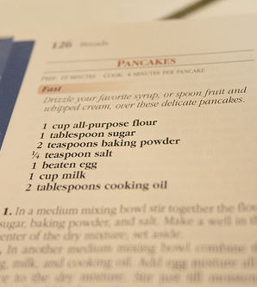
What goes into a research article?
Informative Abstract
Literature Review
Methodology
Scope?
Results
Limitations?
Discussion
Conclusions
Acknowledgements?
References
Appendices?

Slide 31
A Strong Introduction Sets the Scene
1. What are you studying?
2. Why is it important?
3. What is the context, or background?

Slide 32
1: A really clear statement or questions can help…
This study addressed four specific questions:
1) What children’s literature is currently being used in Atlantic Canadian school classrooms?
2) Are teachers in the Atlantic provinces familiar with the work of both national and regional children’s authors and illustrators?...
Howard, 2012, p. 3.

Slide 33
2. BUT only if we know why…
Faced with these numbers, the library decided to investigate alternative modes of reference to reach their patrons… an active approach was needed.
It is clear, then, that mobile technologies offer libraries the opportunity to provide unprecedented access to their collections.
McCabe & MacDonald, 2011, p. 2.;Doi, Mason, & Wiercinski, 2011, p. 3.

Slide 34
3. And have enough BACKGROUND to understand…
Some of the reasons for this trend….
The term “roaming reference” has never been clearly defined….In essence, it is anything occurring away from the confines of the reference desk.
Horwath, 2012, p. 2.; McCabe & MacDonald, 2011, p. 2.

Slide 35
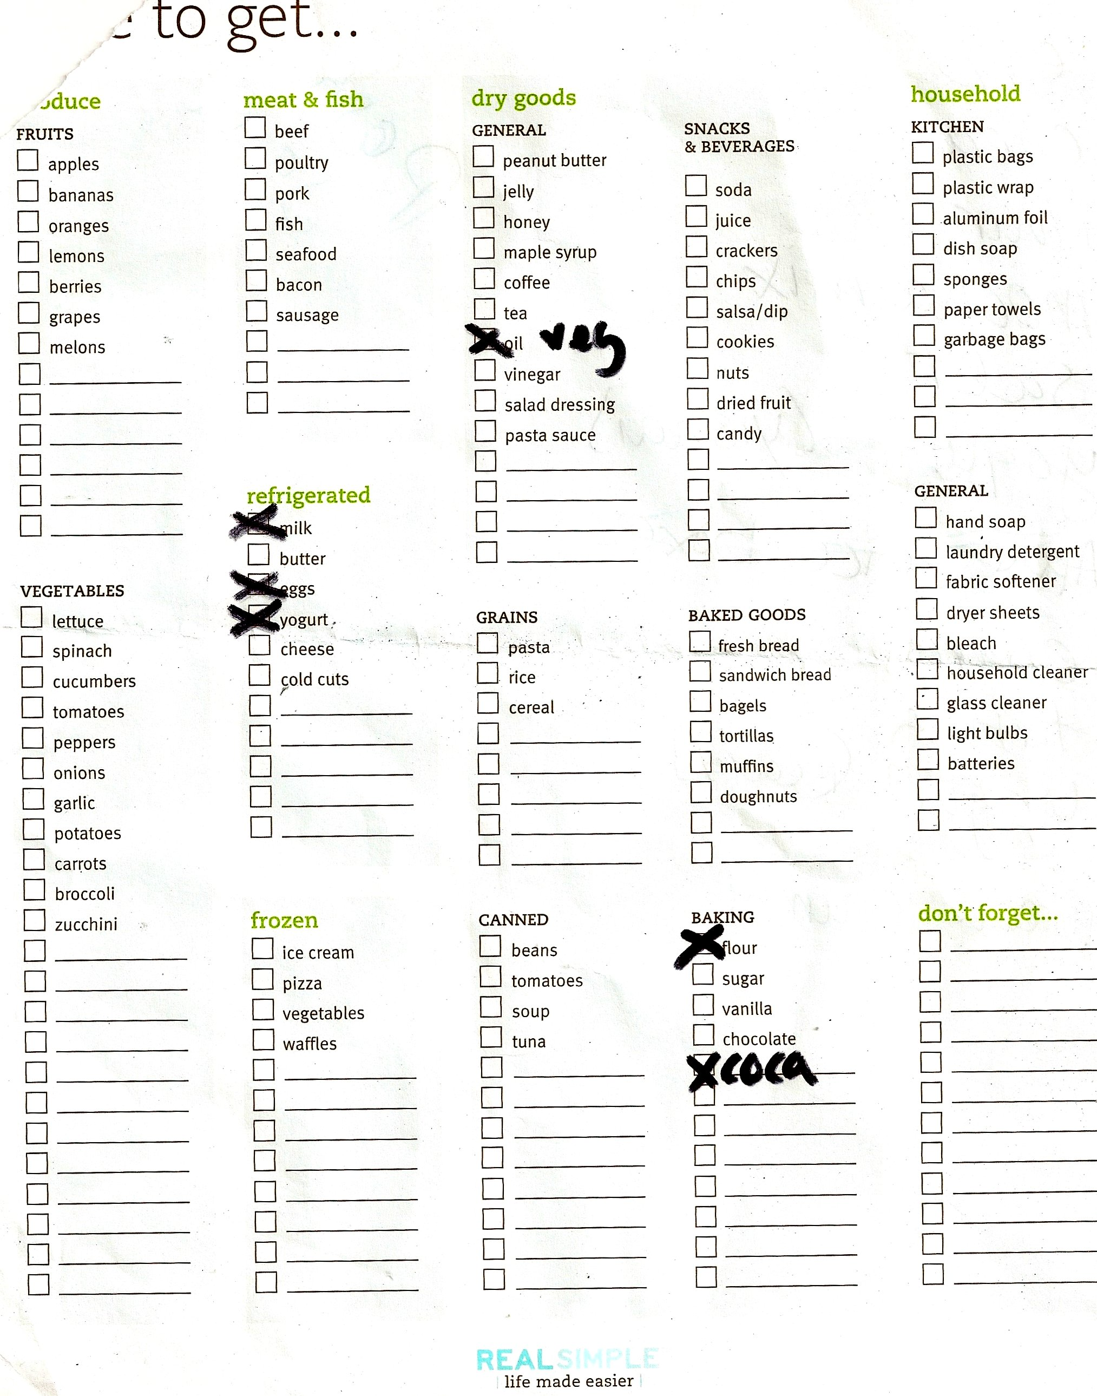
Biggest Pitfall of the Literature Review in the T&R Section

Slide 36
Literature Review Opening Paragraph
While the number of projects in libraries has been increasing, the topic of PM has not been written about as much as other subjects in the library literature (Burich et al. 19; Feeney and Sult 745; Winston and Hoffman 52 and 55). However, within the literature that does exist, there are three aspects of the topic that are described in detail: 1) the PM methodologies used to manage particular library projects, 2) PM methodologies and/or tools for librarians discussed on a general level (i.e., not related to particular library projects) and 3) PM training and skills needed by librarians. What follows is a discussion of the library literature grouped by these three themes.
Horwath, 2012, p. 2.

Slide 37
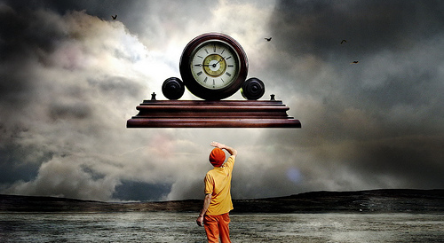

Methodology

Slide 38
A noteworthy methodology section
Peterson, S. S. (2012). (7)2, 1-21.Preschool Early Literacy Programs in Ontario Public Libraries
The multi-method approach has contributed significantly to the validity and robustness of this data. While these children are too young to be interviewed, their "voices" have been captured through observation. All too often our research just examines adult perspectives. The sampling appears to be appropriate; in any case the author(s) has(have) described the limitations of the sampling. There certainly is enough data. Reporting the numbers gave a nice quantitative overview; sharing excerpts from the qualitative data made the number findings come alive.
Anonymous Peer-Reviewer for Partnership.

Slide 39
Some of our best results sections
Make effective use of charts and tables
But… charts and tables that are clear…
And effective summaries of textual data…
So…what DO these look like?

Slide 40
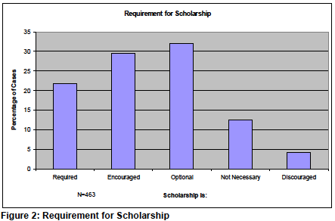
Effective Use of a Bar Chart
Fox, 2007, p. 7.

Slide 41
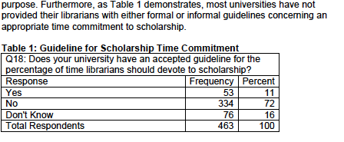
Effective Use of a Table
Fox, 2007, p. 7.

Slide 42
So how might you represent textual data?
Perspectives about Program Goals [Research Question]
School readiness was parents'/caregivers' predominant desired outcome for their children's participation in the library program. It was also an important goal for many library staff members. Parents'/caregivers' gave specific examples of the school readiness behaviours they hoped that their children would develop through participation in the library programs, including statements that they hoped the program would teach their children to "learn to sit and listen" and "learn to interact with other kids".
Stagg Peterson, 2012, p. 6.

Slide 43
The discussion section is where you INTERPRET your results
Your opening sentences might reiterate
your most important findings.
You might start to
compare them to other studies.
Perhaps you question how meaningful some of the definitions are….

Slide 44
So what goes in the Conclusion?
The conclusions are based upon the research described in the body of the manuscript.
There is never any new information…ever.
They are reasonable based upon the findings, and the scope, or the limitations of the research.

Slide 45
In a preliminary read this editor asks…
Is the subject matter topical, of practical use, or of interest to our readers?
Is the scope research, theory, or a substantial review article?
If it is a research article is it complete?
Is it to a minimum standard of research?
If it is a theory or review article is it in sufficient depth?
Is it written to minimum standards of written English, grammar & punctuation?
Is it MLA style?
Is it already published?
Is it anonymous?

Slide 46

To put it visually
Has a trusted
colleague read your
manuscript?

Slide 47

Post peer-review this editor looks for…
Thought given to the
comments of the reviewers &
this editor and appropriate
revisions

Slide 48
Image Credits
Wiese, M. (2008). Pancakes [Online Image]. Retrieved from http://www.flickr.com/photos/93587218@N00/2452029695/
Vidalia_11.(2009). Shopping List [Online Image]. Retrieved from http://www.flickr.com/photos/56832361@N00/3303919983
Koppdelaney, H. (2010). Time Flies [Online Image]. Retrieved from http://www.flickr.com/photos/16230215@N08/4291413264/
Jones, A. (2006). Handshake [Online Image]. Retrieved from http://www.flickr.com/photos/25945304@N00/3575000735/
BetsyJean79. (2007). Doll [Online Image]. Retrieved from http://www.flickr.com/photos/42359338@N00/971611970/

Slide 49
Doi, C., Mason, J., & Wiercinski, J. (2012). 6(1), 1-31.Mobile Access to Audio and Video Collections in Libraries and Other Cultural Institutions
Fox, D. (2007). 2(2), 1-25. The Scholarship of Canadian University Research Librarians. Horwath, J. A. (2012). 7(1), 1-34.How Do We Manage? Project Management in Libraries: An Investigation.
Howard, V. (2012). (7)1, 1-18.The Sea Stacks Project: Enhancing the Use of Regional Literature in Atlantic Canadian Schools.
McCabe, K. M., & MacDonald, J. R. W. (2011). (6)2, 1-15 Reinvigorating Reference through Point of Need Service.
Peterson, S. S. (2012). (7)2, 1-21.Preschool Early Literacy Programs in Ontario Public Libraries

Slide 50
Why Publish in Partnership?
Open access ‒ wide, rapid exposure
Canadian
Rigorous peer-review
Good choice for first time authors
Friendly and supportive

Slide 51
Questions?
David Fox david.fox@usask.ca
Mary Kandiuk mkandiuk@yorku.ca
Ann Smith ann.smith@acadiau.ca

